Slide 1
The try Block
The first step in constructing an exception handler is to enclose the code that might throw an exception within a try block.
The segment in the example labeled code contains one or more legal lines of code that could throw an exception.
try
{
code
}
catch and finally blocks

Slide 2
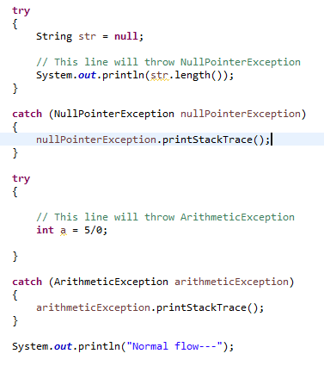
The try Block
We can put each line of code that might throw an exception within its own try block and provide separate exception handlers for each.
String str = null;
// This line will throw NullPointerException
System.out.println(str.length());
// This line will throw ArithmeticException
int a = 5/0;

Slide 3
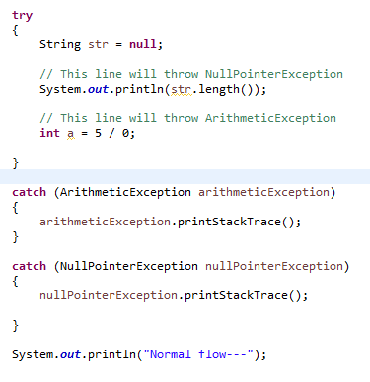
We can put all the code within a single try block and associate multiple handlers with it.
If an exception occurs within the try block, that exception is handled by an exception handler associated with it. To associate an exception handler with a try block, you must put a catch block after it.
The try Block
String str = null;
// This line will throw NullPointerException
System.out.println(str.length());
// This line will throw ArithmeticException
int a = 5/0;

